Slide 1

Heart Disease Detection Using Fuzzy Logic
By:
Anuradha Ramchandran

Slide 2
What is Heart Disease?
The term “heart disease” refers to several types of heart conditions.
There are many different heart conditions and problems which are collectively called heart disease.
The four main types are: coronary heart disease, stroke, peripheral arterial disease and aortic disease.
Coronary artery disease or CAD is the most common type of heart disease in the United States and affects the blood flow to the heart.
Decreased blood flow can cause a heart attack.

Slide 3
Symptoms of Heart Disease
Sometimes heart disease may be “silent” and not diagnosed until a person experiences signs or symptoms of a heart attack, heart failure, or an arrhythmia. When these events happen, symptoms may include:
Heart attack: Chest pain or discomfort, upper back or neck pain, indigestion, heartburn, nausea or vomiting, extreme fatigue, upper body discomfort, dizziness, and shortness of breath.
Arrhythmia: Fluttering feelings in the chest (palpitations).
Heart failure: Shortness of breath, fatigue, or swelling of the feet, ankles, legs, abdomen, or neck veins.

Slide 4
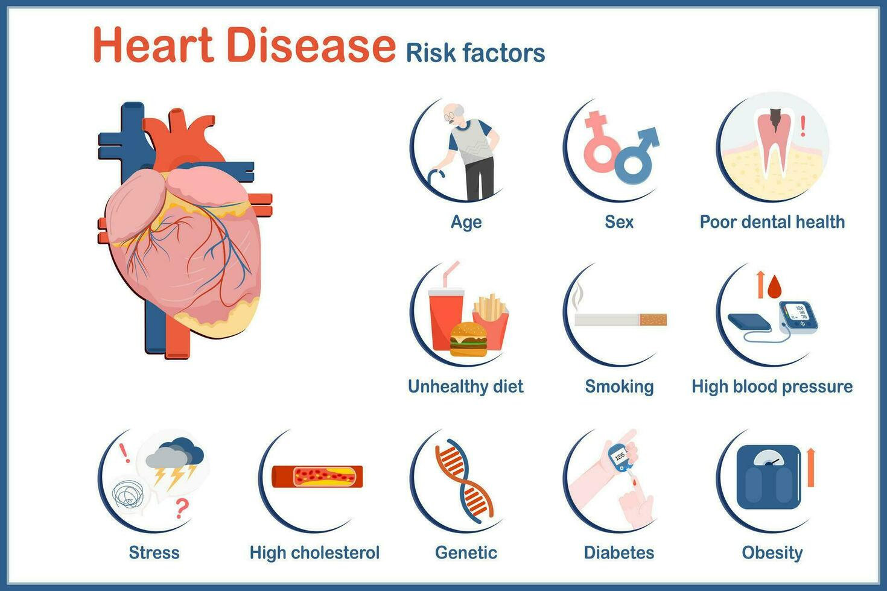
Risk Factors Affecting Heart Disease Risk
High blood pressure, high blood cholesterol, and smoking are key risk factors for heart disease.
Several other medical conditions and lifestyle choices can also put people at a higher risk for heart disease, including:
Diabetes
Obesity
Unhealthy diet
Physical inactivity
Excessive alcohol use

Slide 5

Importance of Early Detection
Impact of Late Diagnosis:
Increased Treatment Complexity
Reduced Treatment Success
Higher Healthcare Costs
Benefits of Early Detection:
Improved Treatment Efficacy
Enhanced Quality of Life
Lower Healthcare Costs
Role in Preventive Healthcare:
Empowering Patients
Population Health Impact
Importance of Regular Check-ups
Notes:
Slide 5: Importance of Early Detection
Impact of Late Diagnosis
Increased Treatment Complexity: Late-stage heart diseases often require more complex and invasive treatments.
Reduced Treatment Success: Delayed intervention may result in a decreased likelihood of successful outcomes.
Higher Healthcare Costs: Late-stage treatments can be more expensive, placing a greater financial burden on both patients and healthcare systems.
Benefits of Early Detection
Improved Treatment Efficacy: Early detection allows for timely and more effective interventions, potentially preventing disease progression.
Enhanced Quality of Life: Early management can contribute to a better quality of life for individuals diagnosed with heart conditions.
Lower Healthcare Costs: Early detection and management can lead to cost savings by avoiding the need for extensive and costly interventions.
Role in Preventive Healthcare
Empowering Patients: Early detection empowers individuals to take proactive measures in managing their cardiovascular health.
Population Health Impact: Early detection contributes to overall public health by reducing the prevalence and severity of heart diseases.
Importance of Regular Check-ups: Regular health check-ups and screenings play a crucial role in identifying risk factors and symptoms at an early stage.

Slide 6
Role of Expert Systems and Machine Learning
Expert systems are computer-based systems mimicking problem-solving ability of a human expert.
They can be used to analyze medical data and emulate expert decision-making.
Machine learning models can also be used to analyze healthcare data for predictions, diagnosis, and treatment planning.
Combining expert systems and machine learning gives better and more accurate results.
Notes:
Knowledge base includes:
Problem facts, rules, concepts and relationships

Slide 7
What is Fuzzy Logic?
Introduced by Lotfi Zadeh in the 1960s.
Deals with reasoning and decision-making in situations where uncertainty, imprecision, and vagueness are present.
Unlike classical (or "crisp") logic, which operates with binary values of true or false, it allows for the representation of degrees of truth.

Slide 8
How can Fuzzy Logic be used?
Can handle uncertain medical parameters with membership functions.
Models how “fuzzy” risk factors can be.
Capable of considering multiple factors at once -> complex case support.
Personalized treatment plans.
Adaptive drug prescriptions and dosages.

Slide 9
What are Decision Trees and Random Forests?
Decision Trees:
Supervised machine-learning algorithm for both classification and regression problems.
Flowchart-like tree structure where each internal node denotes the feature, branches denote the rules, and the leaf nodes denote the result of the algorithm.
C4.5 addresses its limitations by handling both numeric and categorical attributes, introducing pruning, and using a more robust attribute selection measure, Gain Ratio.
Random forests are ensemble algorithms of many decision trees.
They are known for high accuracy and handling large datasets.
Notes:
C4.5, an extension of ID3, addresses its limitations by handling both numeric and categorical attributes, introducing pruning, and using a more robust attribute selection measure, Gain Ratio.

Slide 10
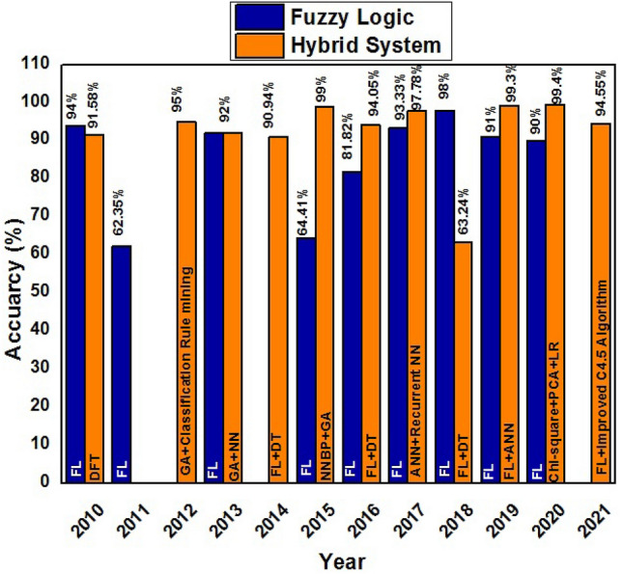
Fuzzy System vs Hybrid Approach

Slide 11
How does the Dataset look like?
The Cleveland Heart Disease dataset is taken from the UCI ML repository.
Consists of 303 records with 76 attributes.
Attributes include information such as age, sex, cholesterol levels, and electrocardiogram measurements.
Research papers tend to use only a subset of 14.

Slide 12
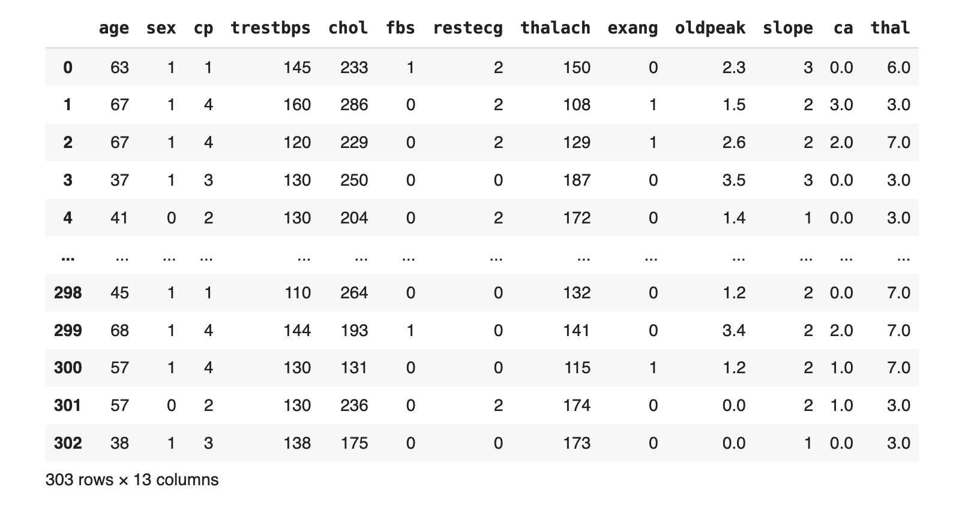

Slide 13
How is a Fuzzy Logic Based Expert System Designed?
Knowledge Acquisition
Rule-base Construction
Implementation and Integration
Testing and Maintenance
Notes:
Knowledge Acquisition: Gather expertise to define fuzzy rules, membership functions, and decision criteria associated with input variables and output actions.
Rule-based Construction: Develop a rule base that translates expert knowledge into fuzzy rules, specifying relationships between linguistic terms of input variables and corresponding fuzzy output conclusions.
Implementation and Integration: Integrate the fuzzy logic-based expert system into the overall software environment, implementing fuzzification, inference, rule aggregation, defuzzification, and validation mechanisms.
Testing and Maintenance: Conduct rigorous testing using representative datasets to validate the system's accuracy. Establish a maintenance plan for updates, ensuring ongoing effectiveness and adaptation to evolving knowledge.

Slide 14
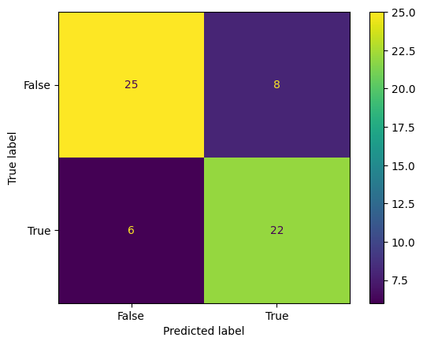
Decision Tree Modelling and Analysis
Scikit-learn’s decision tree algorithm with the criterion set to “entropy” to model C4.5 Algorithm.
Accuracy Obtained: 77%
Notes:
ID3 gives lower accuracy

Slide 15
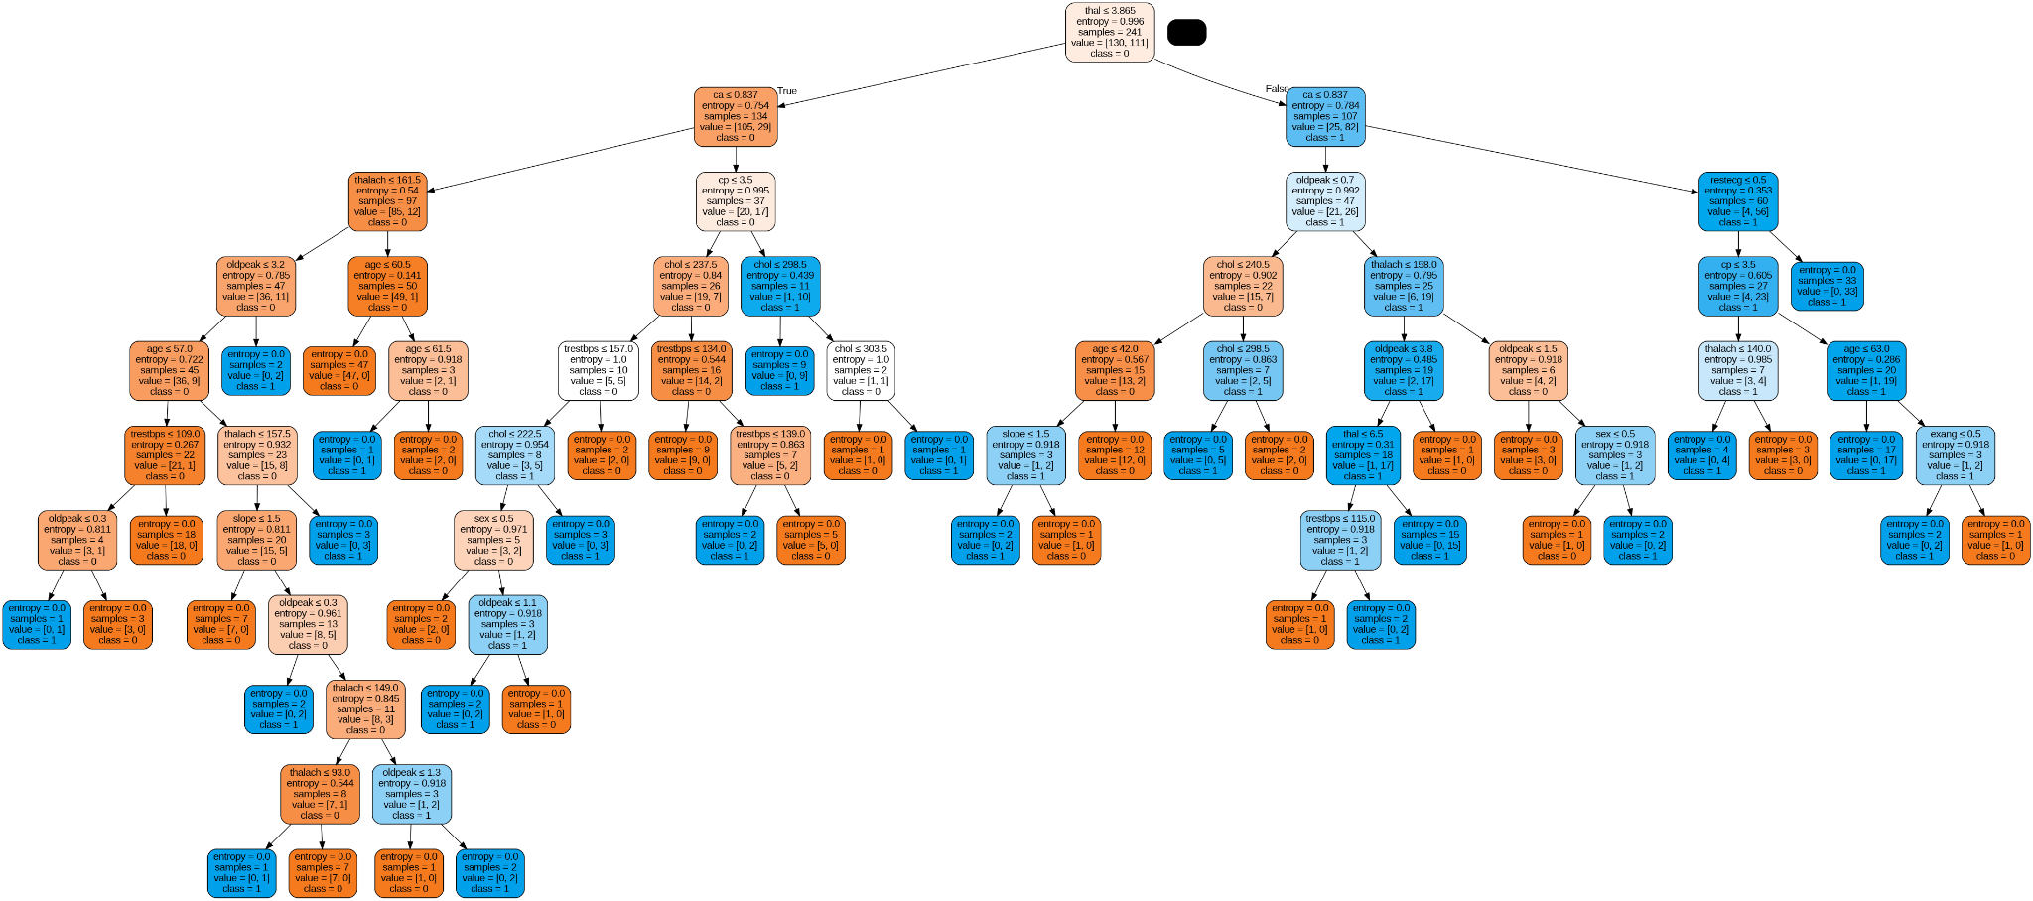

Slide 16
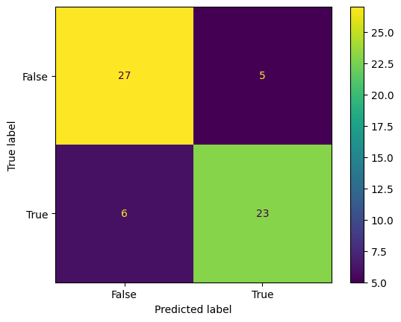
Random Forest Modelling and Analysis
Accuracy: 79%

Slide 17
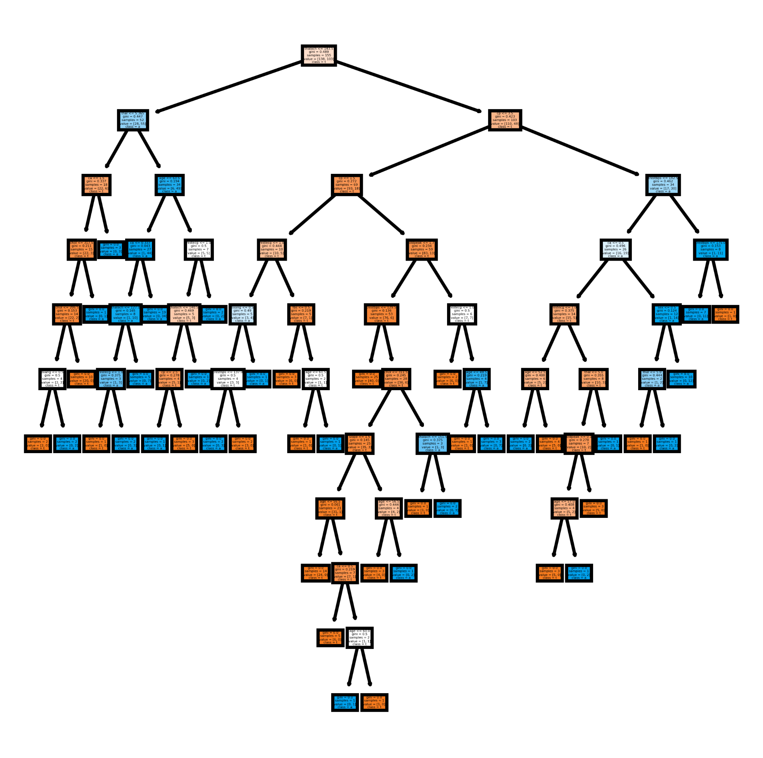

Slide 18
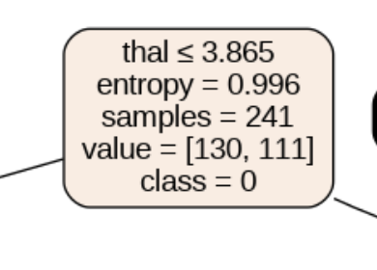
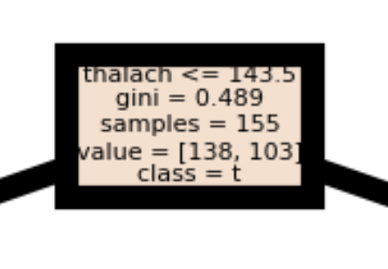
Comparison of Decision Tree and Random Forest
Accuracy: 77% Vs 79%
Root Node Selection:
Decision tree selects ‘thallium scan’ as the root node, whereas Random Forest selects ‘max heart rate’.

Slide 19
Fuzzy System Design
“Control” is a subpackage in the skfuzzy toolkit in Python that is used to provide a high-level API for fuzzy system design.
Fuzzy Control System Definition: involves defining fuzzy input and output variables, specifying membership functions, and creating fuzzy rules within a Control System.
Simulation and Decision Making: facilitates the simulation of the fuzzy control system by providing input values, evaluating fuzzy rules using an inference engine, and obtaining crisp output decisions through aggregation and defuzzification.
Implementation Steps: enables the step-by-step implementation of fuzzy control systems, covering fuzzification, rule evaluation, aggregation, and defuzzification, allowing users to design and simulate decision-making processes based on fuzzy logic.

Slide 20
Membership Functions of Input and Output Variables
chest_pain_values = { 'typical_anginal': 1, 'atypical_anginal': 2, 'non_aginal_pain': 3, 'asymptomatic': 4 }
exercise_values = { 'true': 1, 'false': 0 }
thallium_scan_values = { 'normal': 3, 'fixed_defect': 6, 'reversible_defect': 7 }
sex_values = { 'female': 1, 'male': 0 }

Slide 21
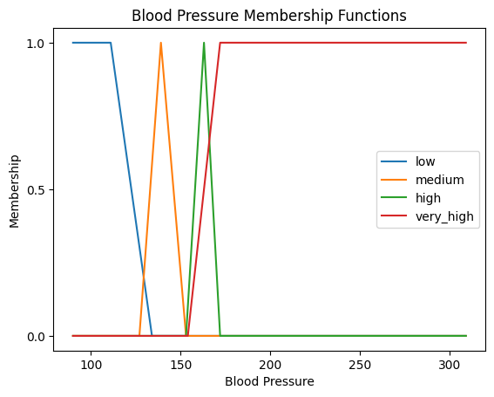
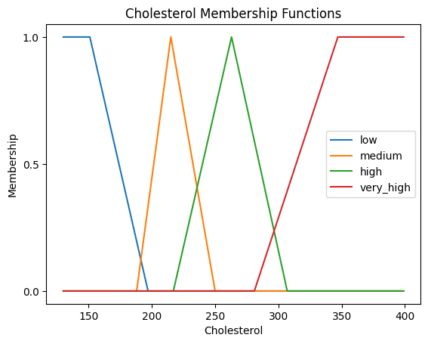
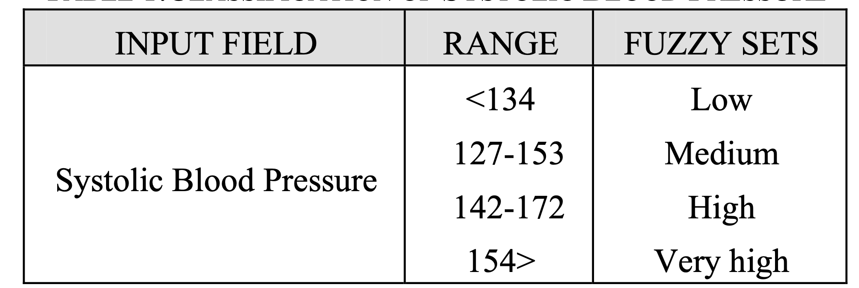
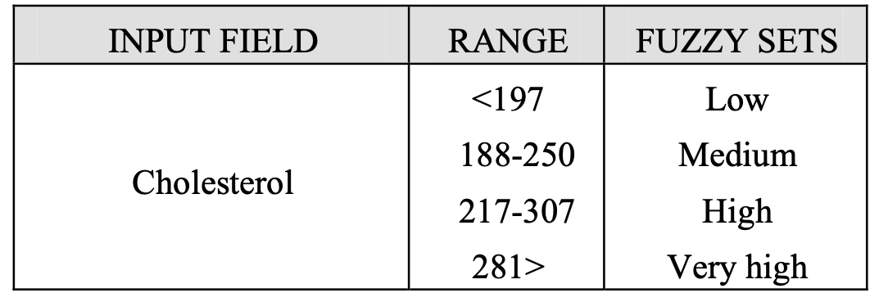

Slide 22
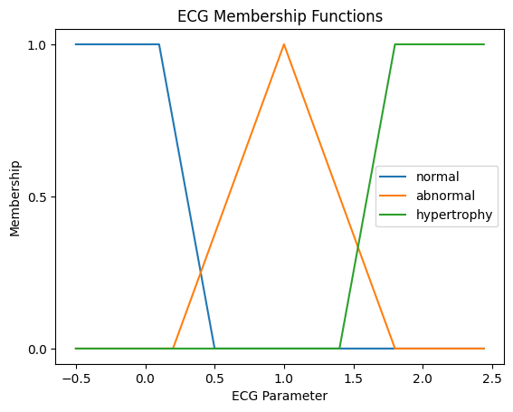
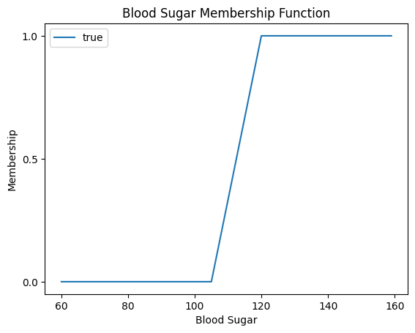
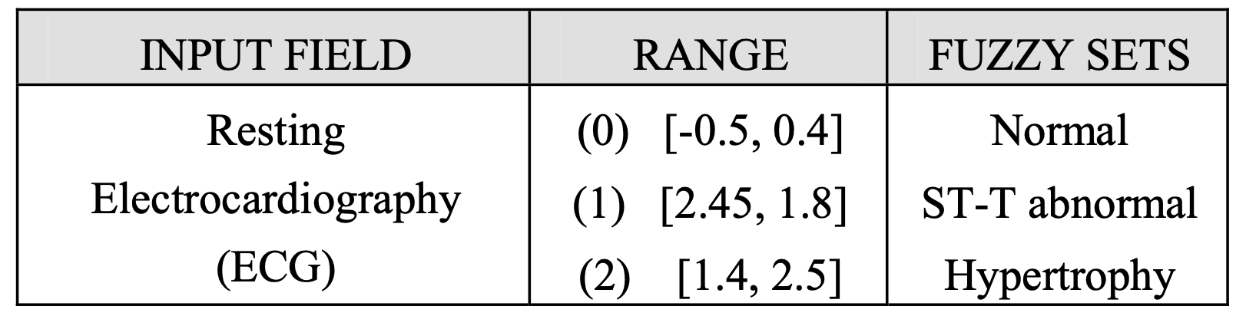

Slide 23
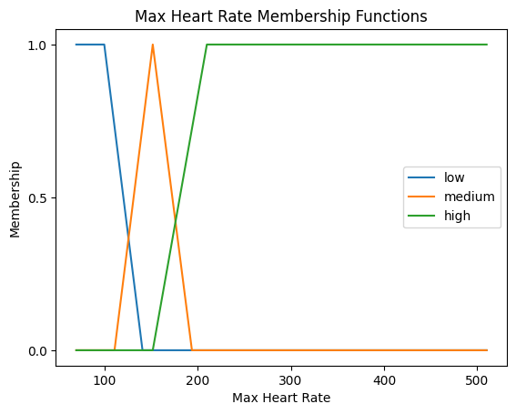
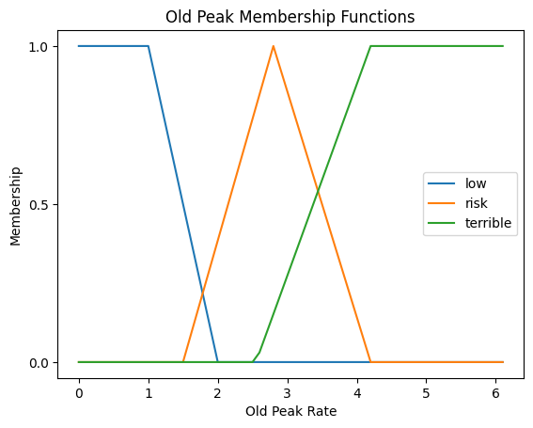
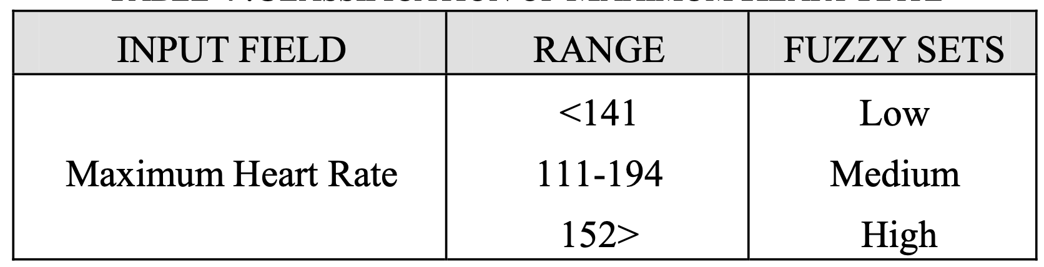
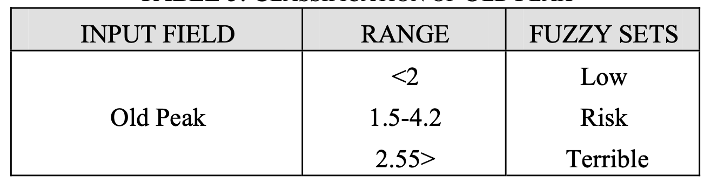

Slide 24
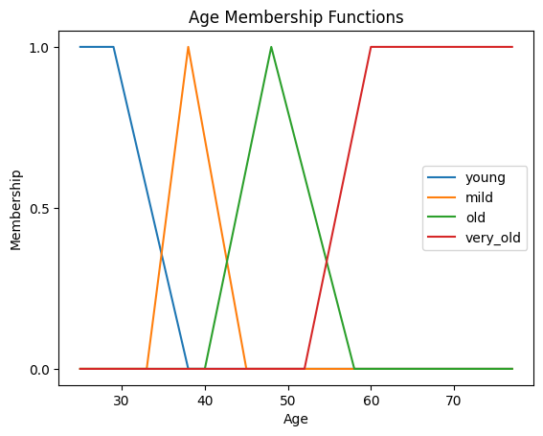
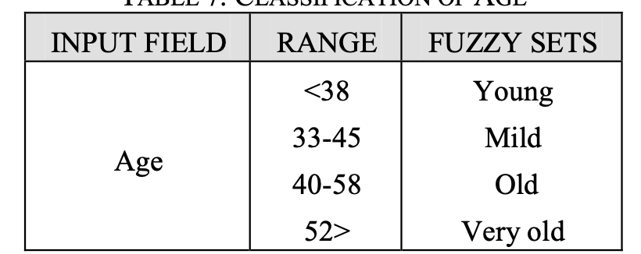

Slide 25
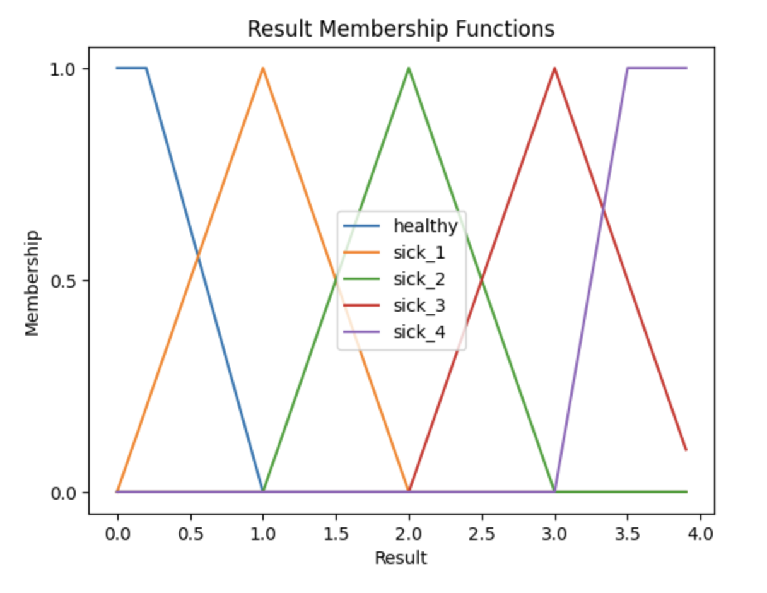
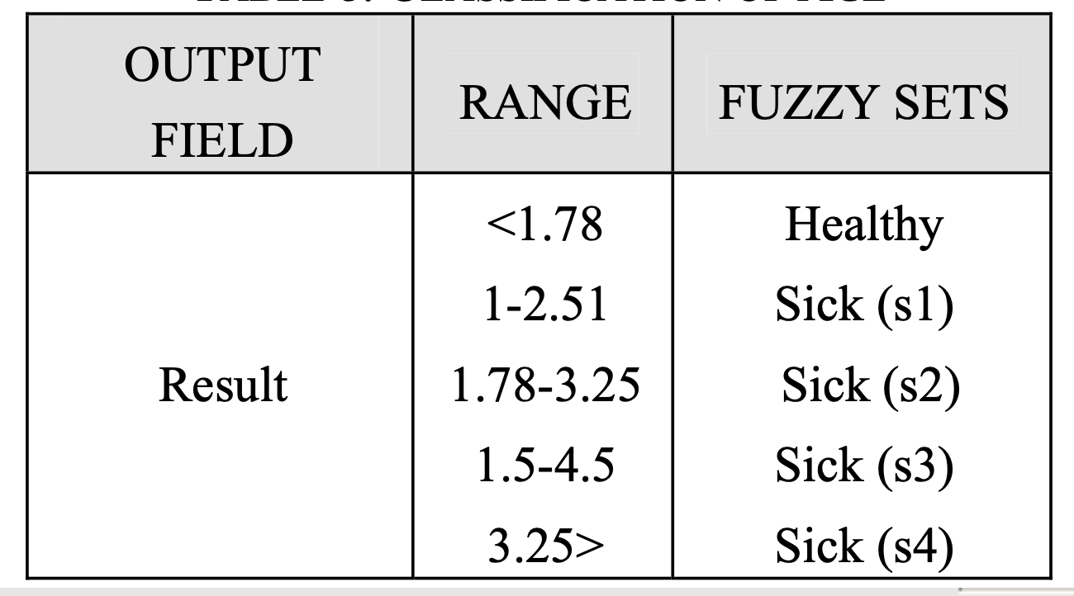

Slide 26
Writing and Adding the Rules to the Control System
The original paper had 44 rules, I added in a few more rules implementing AND and OR based complex rules based on rules from other papers and analysis from the machine learning models.
Each rule has an antecedent from the input variables, and the consequent output result.

Slide 27
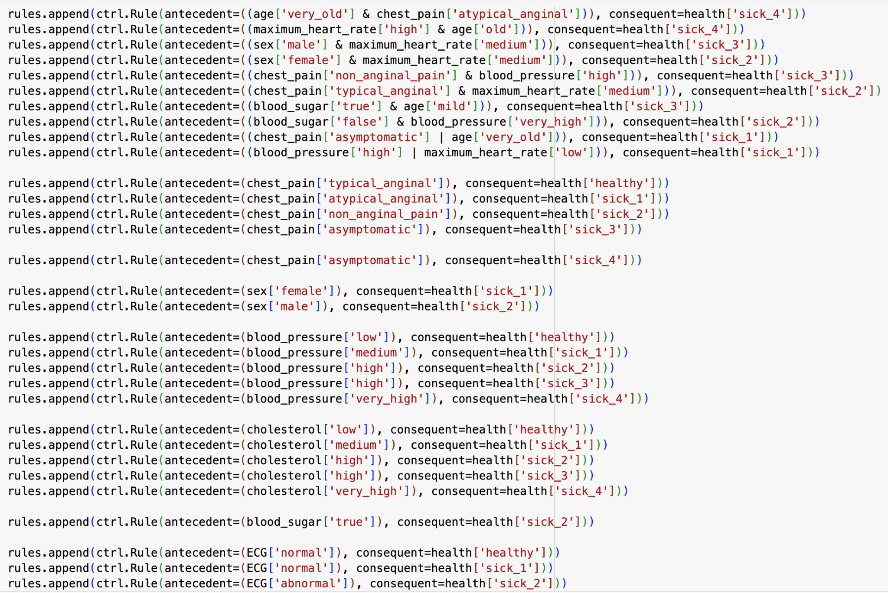

Slide 28
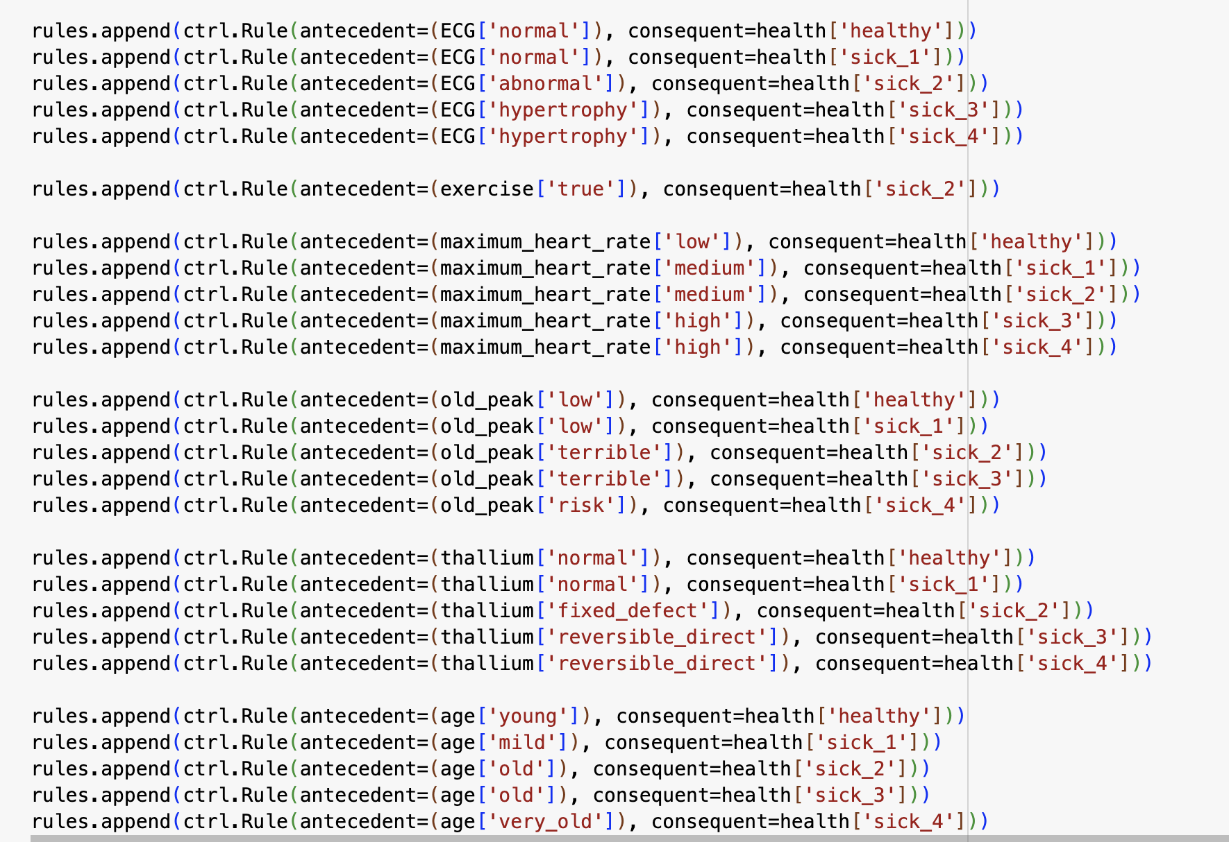

Slide 29
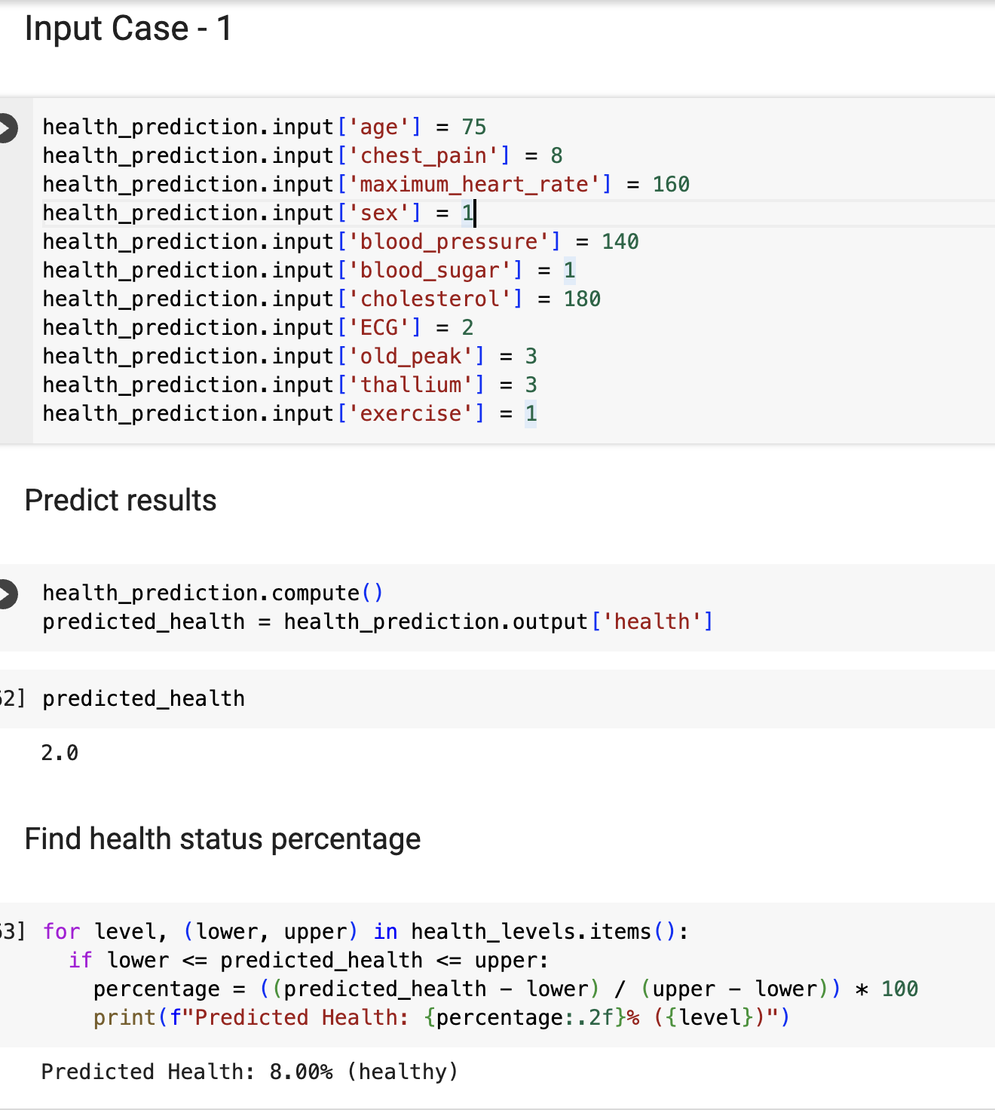
Sample Test Case
health_prediction.input['age'] = 75
health_prediction.input['chest_pain'] = 8
health_prediction.input['maximum_heart_rate'] = 110
health_prediction.input['sex'] = 1
health_prediction.input['blood_pressure'] = 120
health_prediction.input['blood_sugar'] = 1
health_prediction.input['cholesterol'] = 180
health_prediction.input['ECG'] = 2
health_prediction.input['old_peak'] = 3
health_prediction.input['thallium'] = 3
health_prediction.input['exercise'] = 1

Slide 30
Challenges
When building this system, there were a few challenges that I faced:
Defining the right ranges for the membership functions.
Correctly fuzzifying and defuzzifying the input.
Building the rule base - adding extra rules to the ones from the paper.

Slide 31
Future Potential of Fuzzy Logic and Expert Systems
Remote Patient Monitoring: real-time assessments, trigger interventions and ensure proactive healthcare.
Drug Discovery: analyze potential side effects, predict drug interactions and analyze complex biological data.
Chronic Disease Management: continuous monitoring, personalized treatment plans, and early detection of worsening health.
Notes:
Fuzzy systems can be employed in remote patient monitoring applications to analyze streaming health data, providing real-time assessments of patients' conditions. Expert systems can interpret these assessments and trigger alerts or interventions when necessary, enhancing proactive healthcare management.
Fuzzy logic and expert systems can streamline the drug discovery process by analyzing complex biological data. They can aid in predicting drug interactions, assessing potential side effects, and optimizing drug formulations, accelerating the development of new therapeutic solutions.
Fuzzy logic and expert systems can play a vital role in chronic disease management by providing continuous monitoring, personalized treatment plans, and early detection of exacerbations. This can lead to improved patient outcomes and a reduction in hospitalization rates.

Slide 32
Q & A

Slide 33
Thank You!

